Slide 1

E-Commerce Behavior Data
DATA MANAGEMENT AND BIG DATA
ALY6110, SPRING 2020
CRN NUMBER: 81984
PRESESNTED BY - EPSILON
Keyur Shah (shah.keyur@husky.neu.edu)
Khushboo Oza (oza.kh@husky.neu.edu)
Rishhi Kumar (janakiraman.r@husky.neu.edu)
Reetika Chaturvedi (chaturvedi.re@husky.neu.edu)
Shruti Sawale(sawale.s@husky.neu.edu)

Slide 2
SUMMARY
The main objective of this project is to understand and analyze how to use big data technologies and concepts on a real time dataset and provide data driven insights to the organization.
The big data technologies and tools used for this project includes - apache spark, spark sql and pyspark.
Using these big data tools, we have analyzed the behavioral data of an ecommerce data and provided useful data driven insights which can help the organizations to make useful decisions.

Slide 3
Goal and Objective
Customer Behavior Analysis
Which brand is most preferred under various categories
Highest revenue generating brands under a particular category
The Brand and Categories generating maximum Revenue

Slide 4
DATA VARIABLES
Event_Time
Event_Type
Product_ID
Category_ID
Category_Code
Brand
Price
User_ID
User_Session

Slide 5
DATA CLEANING
The initial dataset was so huge
We have used Python to clean the Raw data .
The dataset after cleaning comprises 40 million rows with unique data and 9 attributes.

Slide 6
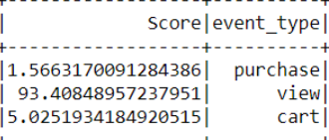
ANALYSIS 1 – CUSTOMER BEHAVIOUR analysis
Almost 93% of the customers online just view the product.
Around 5% of the customers who browse the ecommerce website add their products to the cart and only1.5% of them purchase it.

Slide 7
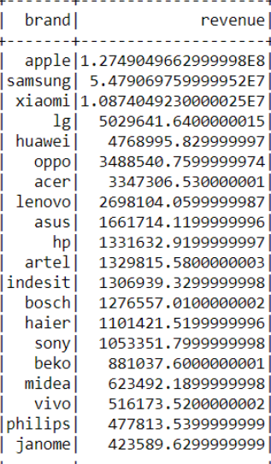
ANALYSIS 2 - The Brand GENERATING MOST REVENUE
Out of all the products that are sold through the ecommerce website the maximum revenue is because of apple.
These stats will help the brands to increase their market value by making more advertisements and other commercials
Apple as a brand generates maximum Revenue.

Slide 8
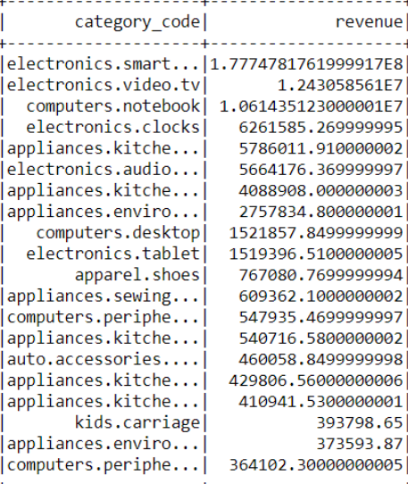
The CATEGORY GENERATING MOST REVENUE
The most purchased product online is the Smartphones followed by other electronic appliances like TV , computer and so on.

Slide 9
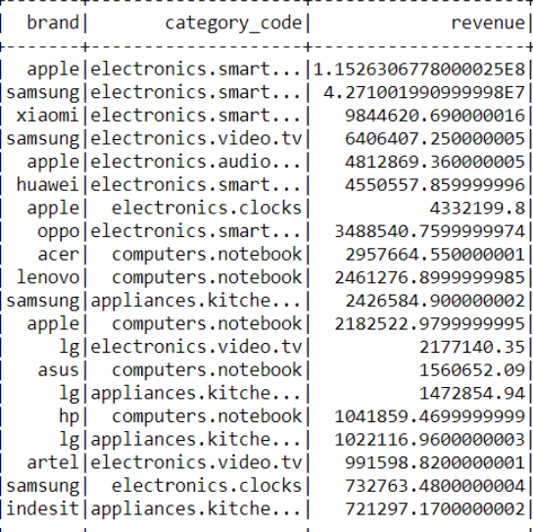
ANALYSIS 3 – Highest Revenue generating BRANDS under a particular category
Out of all the products from various different brands apple is the Highest revenue generating brand under electronics – smartphones category
People prefer to buy Apple iPhones because of its quality and brand value.
This data will help the company to analyze the trends and predict which brand or product will be trending in the near future

Slide 10
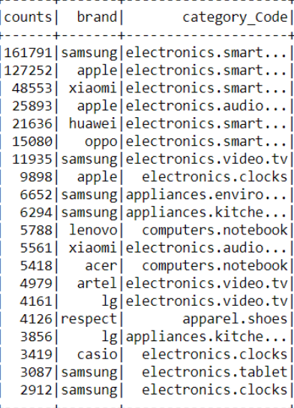
ANALYSIS 4 - which BRAND is most preferred UNDER VARIOUS Categories?
Samsung is the most preferred brand under various categories.
This data will help the company to analyze the trends and predict which brand or product will be trending in the NEAR future

Slide 11
Challenges and Benefits of working with this dataset
PROS
CONS
Faster Processing
Easy to manage large volume of data
Good User Interface
Simple and Dynamic in nature
Smooth database interfacing
Classpath exceptions
Does not support multi user environment

Slide 12
CONCLUSION
Billions of tuples of data are produced every minute and needs to deal with real-time data leading to the implementation of big data analytics in the ecommerce sector.
Provide Data driven insights to the eCommerce companies
After analyzing the number of purchases taking place, the brand that contributed maximum to the revenue and the product that generated the most revenue is “Apple”.

Slide 13
REFERENCES
Kechinov, M. (2019, December 9). eCommerce behavior data from multi category store. Retrieved from https://www.kaggle.com/mkechinov/ecommerce-behavior-data-from-multi-category-store
Bochet, C. (n.d.). Get Started with PySpark and Jupyter Notebook in 3 Minutes. Retrieved May 14, 2020, from https://www.sicara.ai/blog/2017-05-02-get-started-pyspark-jupyter-notebook-3-minutes

Slide 14
QUESTIONS??
THANK YOU

